Slide 1
TCMID Generator User Manual

Slide 2
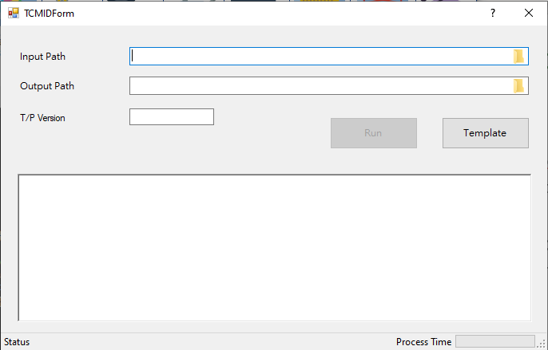
TCMID Generator
Purpose
Based on limit sheet testname to generate TCMID.
Test type separate with four categories: Conti, IDS, Leakage, Others.
LDO test item has special rule in certain combine with testname.
Input: folder contains limit file (.txt) and designate TP version Output: tool generate new limit file (.xlsx & .txt) and report (.xlsx)

Slide 3
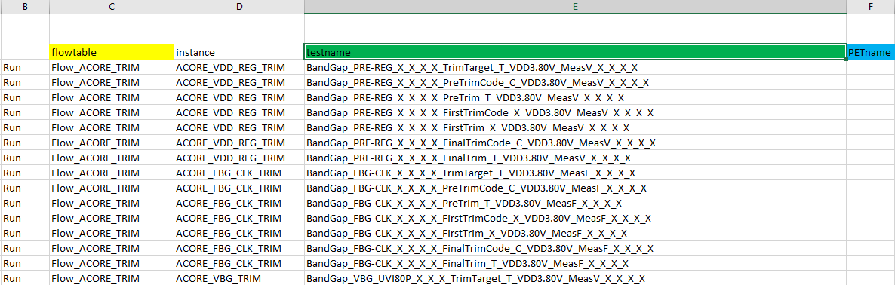
Input Limit Sheet
3 Columns needed
Sheet should contains 3 columns: flowtable, testname, PETname

Slide 4
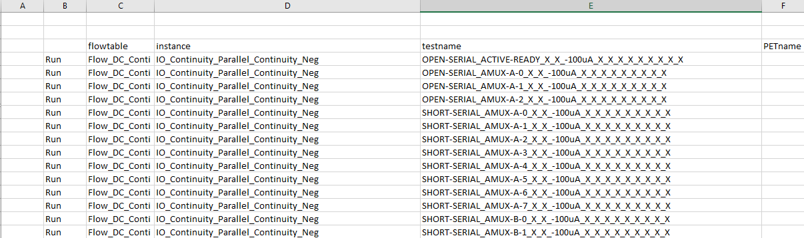
Input Limit Sheet – Conti
3 Columns needed
Sheet should contains 3 columns: flowtable, testname, PETname

Slide 5
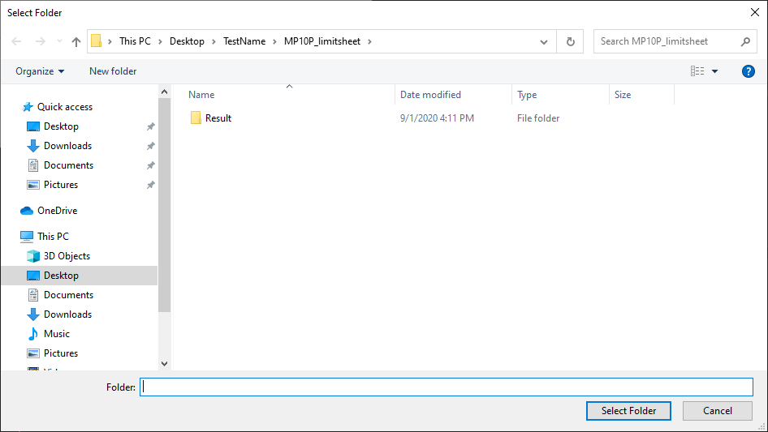
Output Path
Tool will create Result folder under user selected path

Slide 6
TCMID Generate Rule
Sort according to flowtable which based on _TRIM and _PostBurn, exclude _LV, _HV, _ULV
No sort for DC / IDS / Leakage limit file
Gen TCMID (detail format in next page)
Replace group13 with TCMID and then porting to column PETName

Slide 7
TCMID Format (1/2)
Based on column testname then split into different groups by char “_”
Group1: BandGap => TCMID: BANDGAP Group1: no digit => TCMID: BANDGAP.00 Group8: T => TCMID: BANDGAP.00.T0001 (digit starts from 0001)
Group1: Buck4 => TCMID: BUCK Group1: digit 4 => TCMID: BUCK.04 Group8: C => TCMID: BUCK.04.C0002

Slide 8
TCMID Format (2/2)
Based on column testname then split into different groups by char “_”
Group1: Buck => TCMID: BUCK Group1: digit 4 => TCMID: BUCK.04 Group8: X & Group7: P => TCMID: BUCK.04.P0005

Slide 9
TCMID Format Summary
Format rule list as below:
Group8 | Group7 | TCMID
C |  | C
T |  | T
X | P | P
X | SWP5 | S
X | FINALTRIMGNG or POSTBURNGNG | T
X | Other else | Empty string

Slide 10
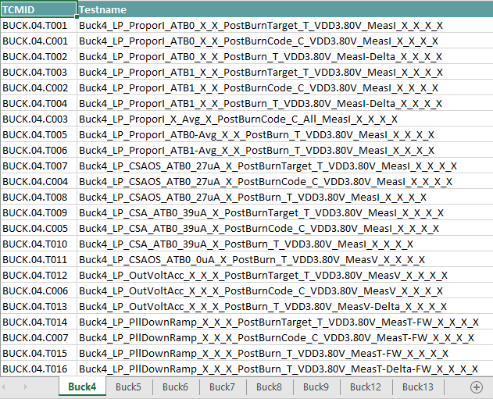
Output Report
Report will separate with different block name

Slide 11
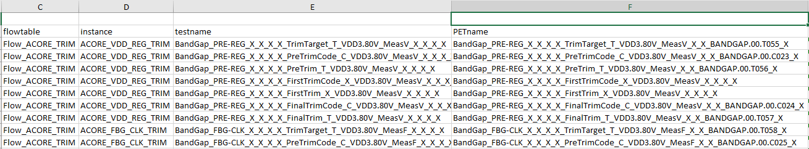
Output Limit File
Replace Group13 with TCMID and then porting to PETName

